Slide 1
Google Analytics
Presented By
Tina Shrestha

Slide 2
Introduction To Google Analytics
Google Analytics is like a detective for your website.
It keeps tabs on who visits, where they come from, and what they do on your site.
It's like having a backstage pass to your online performance.

Slide 3
Set Up Google Analytics
Sign Up or Log In: Create or log in to your Google Analytics account.
Create Property: Add your website as a property in Google Analytics. You'll get a unique tracking code.
Get Tracking Code: Copy the provided tracking code.

Slide 4
Set Up Google Analytics
Place Code on Website: Add the tracking code just before the closing </head> tag on every page you want to track.
<!-- Google tag (gtag.js) --><script async src="https://www.googletagmanager.com/gtag/js?id=G-8RFBKF84X6"></script><script> window.dataLayer = window.dataLayer || []; function gtag(){dataLayer.push(arguments);} gtag('js', new Date()); gtag('config', 'G-8RFBKF84X6');</script>
Test Setup: Verify if Google Analytics is collecting data by visiting your site and checking the dashboard.

Slide 5
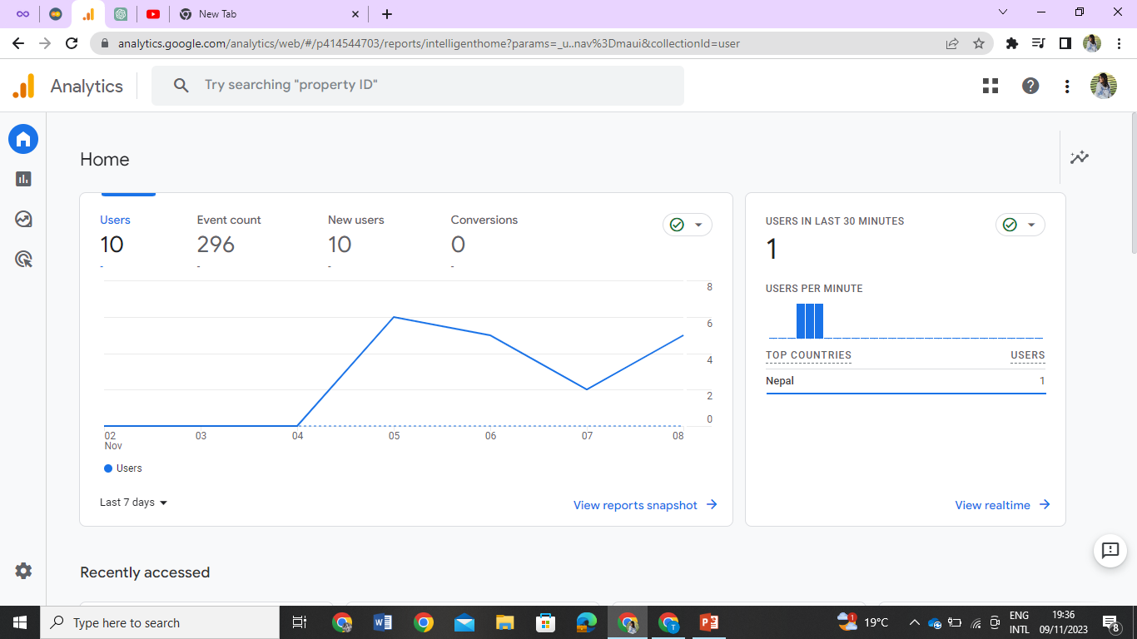

Slide 6
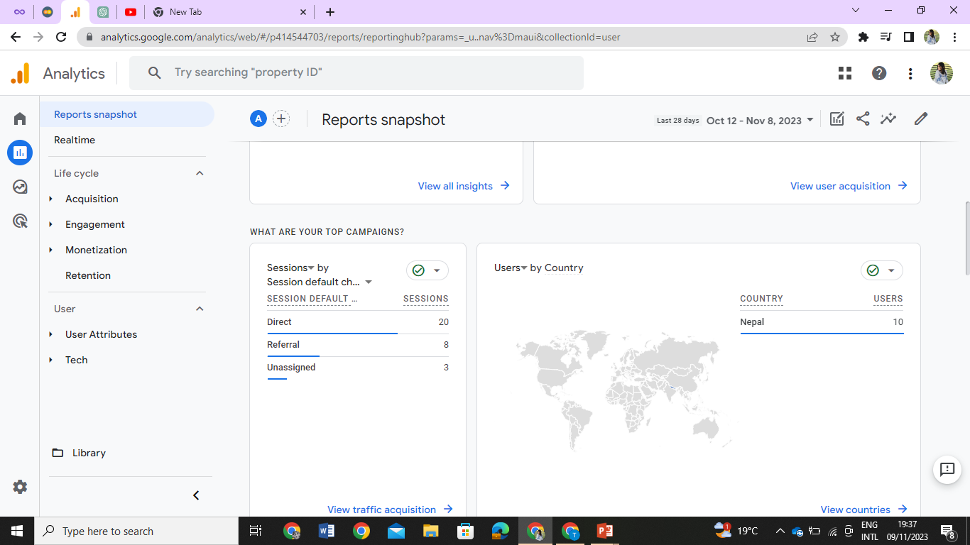

Slide 7
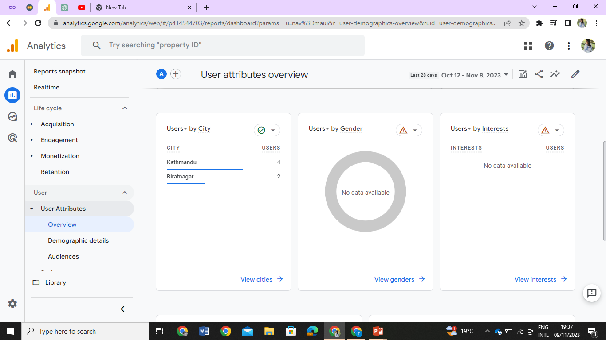

Slide 8
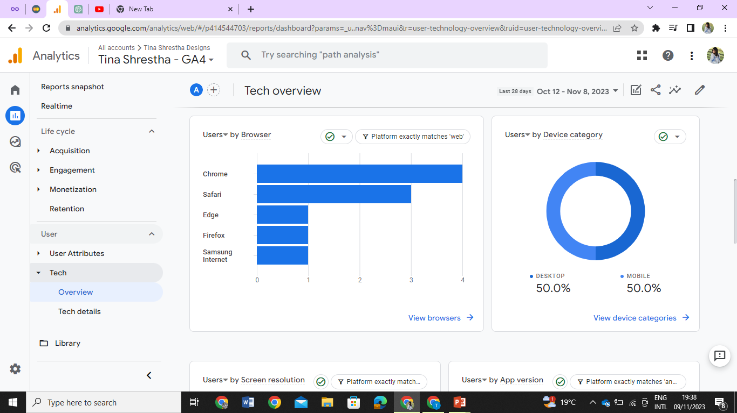

Slide 9


